Slide 1

Memory Technologies Spring 2024
Hamed Farbeh
farbeh@aut.ac.ir
Department of Computer Engineering
Amirkabir University of Technology

Slide 2
Reference (for this lecture)
Design Exploration of Emerging Nano-scale Non-volatile Memory, Hao Yu and Yuhao Wang, Springer, 2014
Memory Technologies, Spring 2024, AUT, Tehran, Iran

Slide 3
Nanoscale Nonvolatile Memories
SRAM
Fastest memory
Significant leakage power
Limited capacity (few megabyte)
DRAM
Fastest after SRAM
Large refresh power in large capacity
Flash
No leakage power
Slow
Limited endurance
Memory Technologies, Spring 2024, AUT, Tehran, Iran

Slide 4
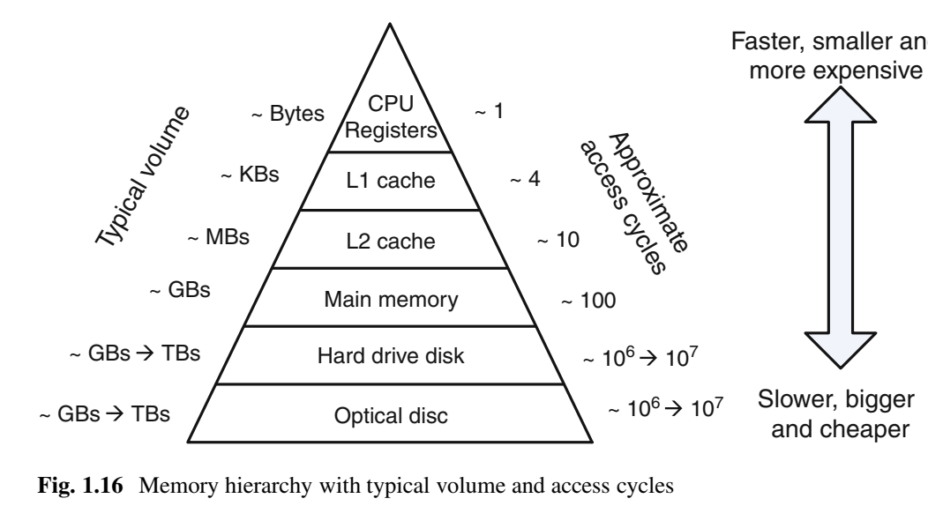
Nanoscale Nonvolatile Memories
Memory Hierarchy
Memory Technologies, Spring 2024, AUT, Tehran, Iran

Slide 5
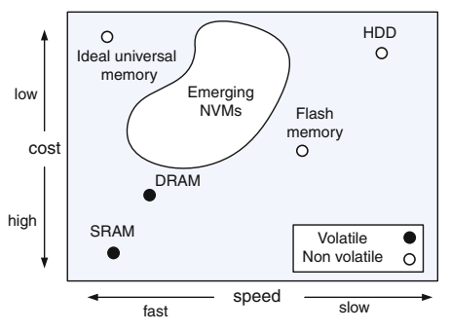
Nanoscale Nonvolatile Memories
Memory Technologies, Spring 2024, AUT, Tehran, Iran

Slide 6
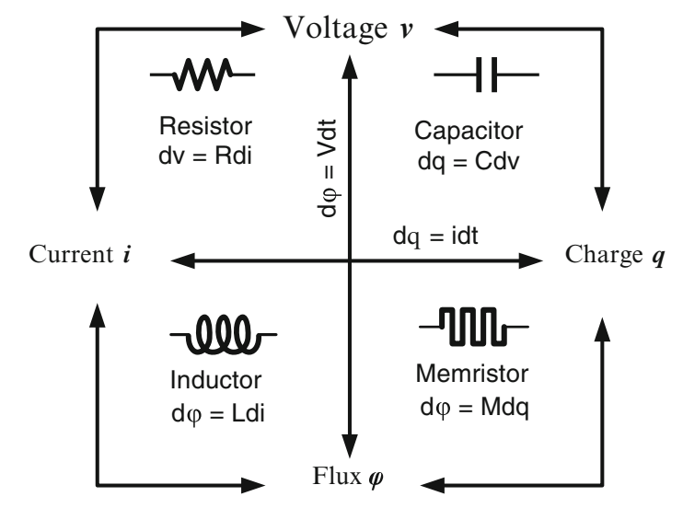
Resistive Random-Access Memory
Memory Technologies, Spring 2024, AUT, Tehran, Iran

Slide 7
Resistive Random-Access Memory
Memristor
Predicted in 1976 by Leon Chua
Discovered 30 years later in HP Labs
Its resistance is determined by the current passed through in the past as if it can remember its history
When current flows in one direction, its electrical resistance increases
When current flows in the opposite direction, resistance decreases
When the current is stopped, retains its previous resistance
Memory Technologies, Spring 2024, AUT, Tehran, Iran

Slide 8
Memristor
Bistable states
High resistance
Low resistance
Write operation
Applying large current: changes its resistance rapidly
Read operation
small current is applied to detect its resistance without significantly changing its resistance
First physical realization
2008: HP Labs
Memory Technologies, Spring 2024, AUT, Tehran, Iran

Slide 9
Conductive Bridging Memory
CBRAM OR programmable metalization cell (PMC)
Two-terminal cylinder-shaped nanoscale device
Each CBRAM memory cell
two metal electrodes
One relatively inert (e.g., tungsten)
One electrochemically active (e.g., silver or copper)
A solid electrolyte between them
Within the solid electrolyte, there exists a vertical conductive filament that grows from the inert electrode
Memory Technologies, Spring 2024, AUT, Tehran, Iran

Slide 10
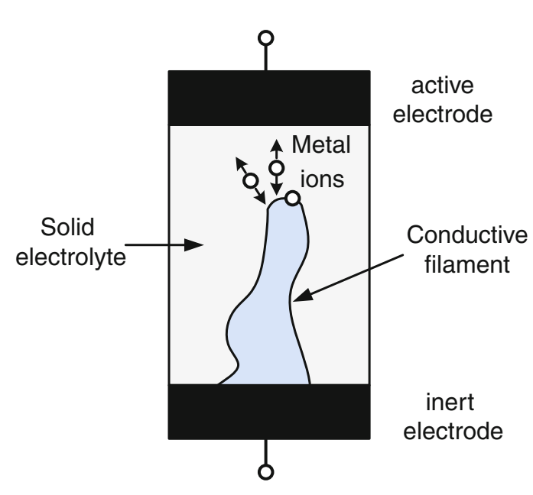
Conductive Bridging Memory
CBRAM OR programmable metalization cell (PMC)
Filament vertically growth by active voltage
Electrode bridge together
Low-resistance or ON-state
Filament vertically shrinks by negative voltage
High-resistance or OFF-state
Memory Technologies, Spring 2024, AUT, Tehran, Iran

Slide 11
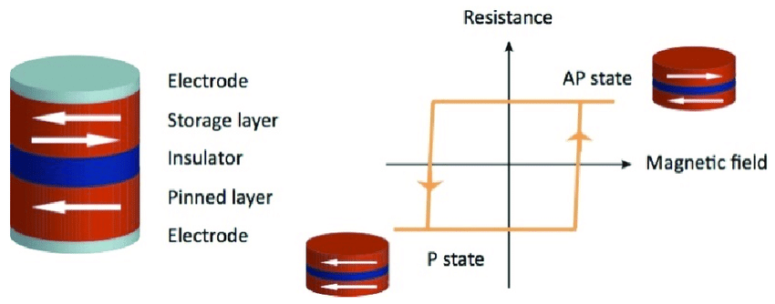
Magnetoresistive Random-Access Memory
Giant magnetoresistance (GMR): 1988
Groups of Albert Fert of the University of Paris-Sud, France
Peter Grünberg of Forschungszentrum Jülich, Germany
GMR Effect
A significant change in the electrical resistance
Depending on the magnetization of adjacent ferromagnetic layers
Memory Technologies, Spring 2024, AUT, Tehran, Iran

Slide 12
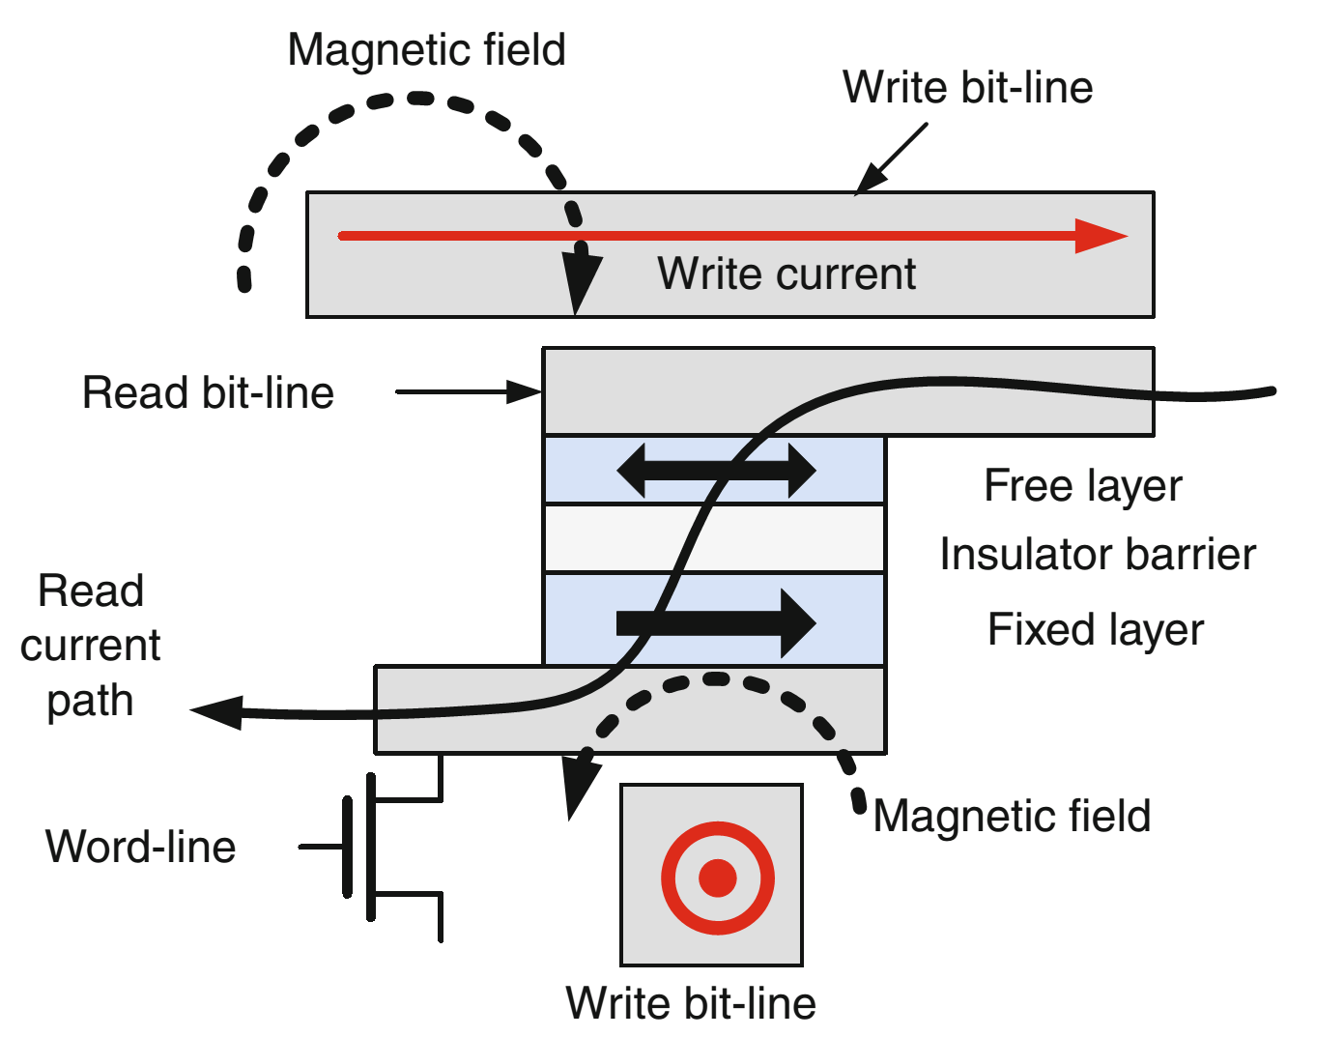
Magnetoresistive Random-Access Memory
MRAM: Magnetoresistive random-access memory (MRAM)
Toggle mode MRAM
First generation of the MRAM
External magnetic field is needed
Current-induced magnetic field:
To be compatible with the electronic system
Memory Technologies, Spring 2024, AUT, Tehran, Iran

Slide 13
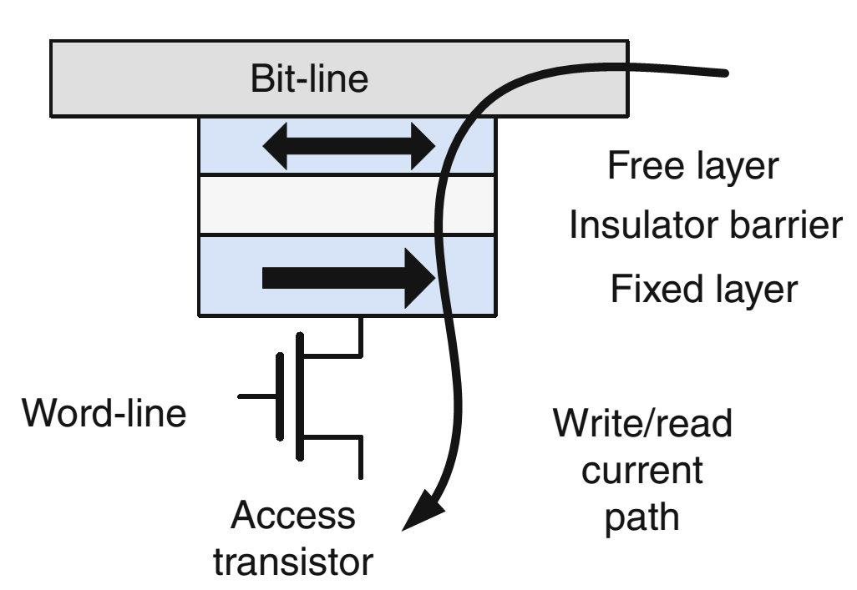
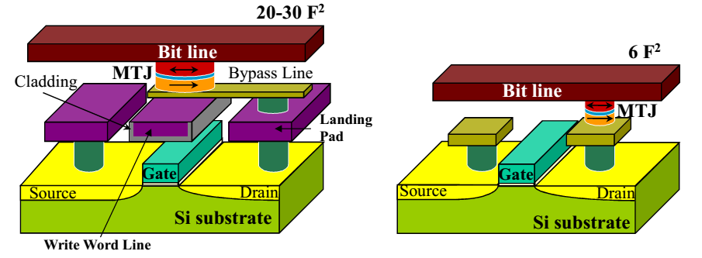
Magnetoresistive RAM
Spin-Transfer Torque MRAM (STT-MRAM)
Based on
Spin-polarized current-induced MTJ switching
spin-transfer torque effect
Fast, lower power consumption, better scalability
Spin-transfer phenomena
Spin polarized current
Memory Technologies, Spring 2024, AUT, Tehran, Iran

Slide 14
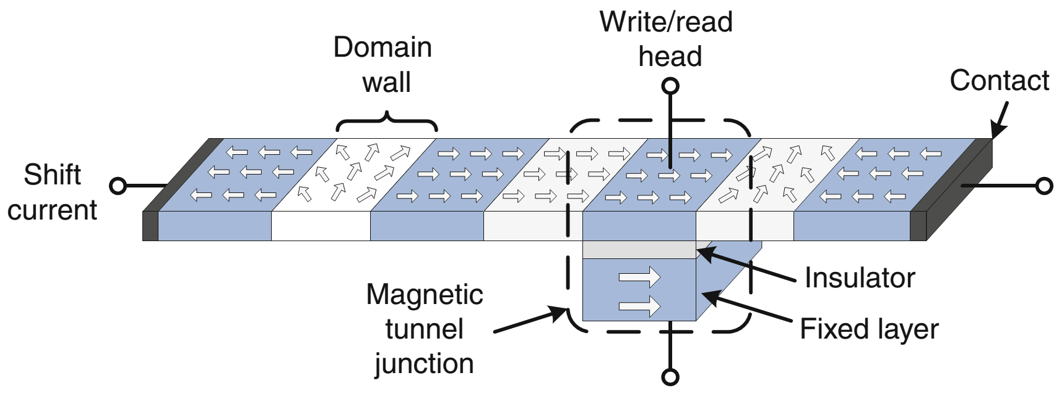
Racetrack Memory
Racetrack or Domain Wall
A thin ferromagnetic film strip
Consists of many magnetic domains
Train-like domains can be pushed to move bidirectionally synchronously
Memory Technologies, Spring 2024, AUT, Tehran, Iran

Slide 15
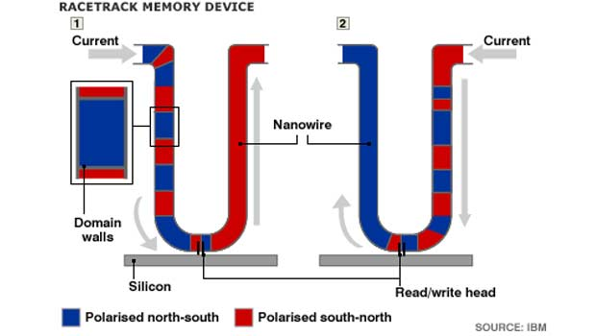
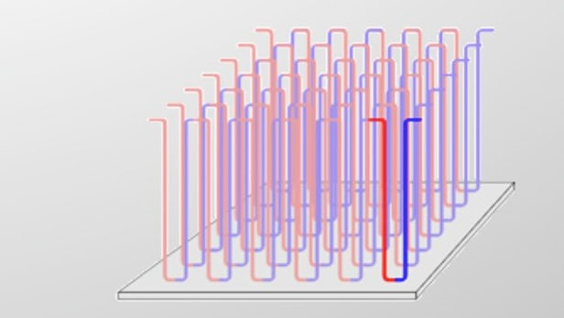
Racetrack Memory
Racetrack or Domain Wall
Access time?
RAM?!
Density?
Memory Technologies, Spring 2024, AUT, Tehran, Iran

Slide 16
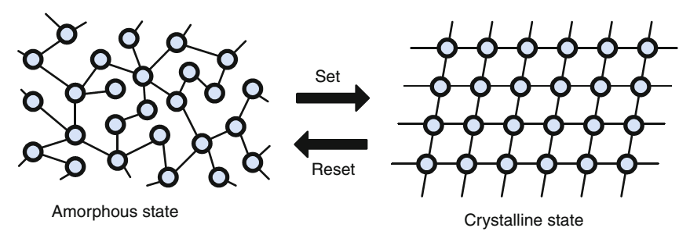
Phase-Change RAM
PCM
Phase changing technology of chalcogenide materials such as Ge₂SbTe₅ (GST)
Two different stable states
Crystalline
Amorphous
Memory Technologies, Spring 2024, AUT, Tehran, Iran

Slide 17
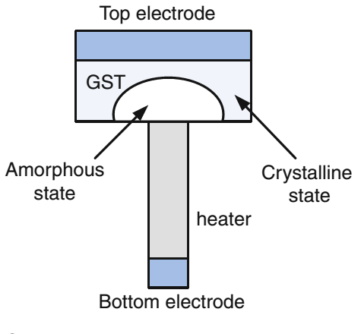
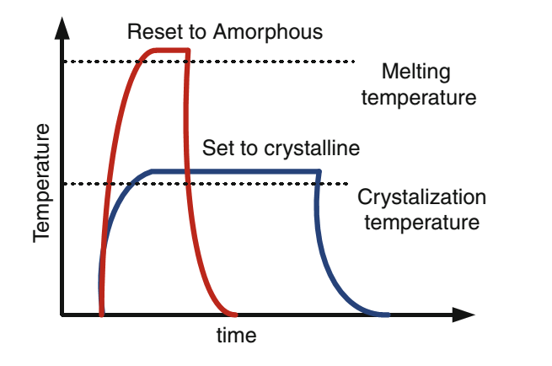
Phase-Change RAM
The chalcogenide crystal structure can be thermally switched between the two states
Memory Technologies, Spring 2024, AUT, Tehran, Iran

Slide 18
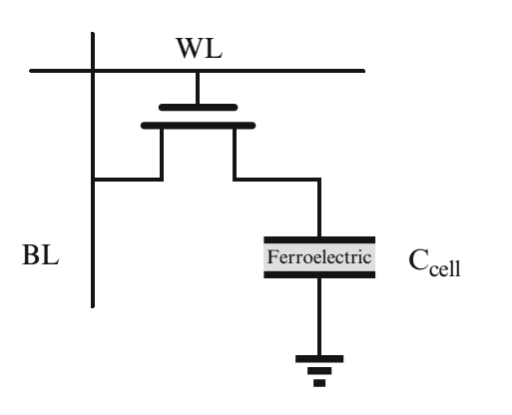
Ferroelectric Random-Access Memory
FeRAM
Ferroelectric capacitor
Ferroelectric instead of dielectric material
Ferroelectric capacitors characteristics
Have two stable states
Retain their states without electrical power
Memory Technologies, Spring 2024, AUT, Tehran, Iran

Slide 19
Ferroelectric Random-Access Memory
Bistable states
Polarization states of the ferroelectric material
Positive
Negative
Write operation
±V_{DD} is applied across the ferroelectric capacitor
Read operation
Float BL
Distructive
Memory Technologies, Spring 2024, AUT, Tehran, Iran

Slide 20
FeRAM
Pros
No leakage and refresh power
Unlimited write-erase cycle (10¹⁵)
Faster than flash
Symmetric read/write
Cons
Density and scaling
Manufacturing difficulties
Memory Technologies, Spring 2024, AUT, Tehran, Iran

Slide 21
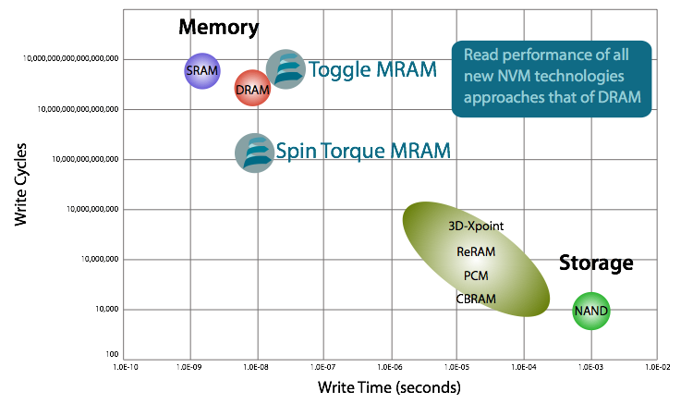
Conclusion
Memory Technologies, Spring 2024, AUT, Tehran, Iran

